Slide 1
Football Transfers Between 2000-2018
Done by: Hamza Al Hajj Chehade

Slide 2
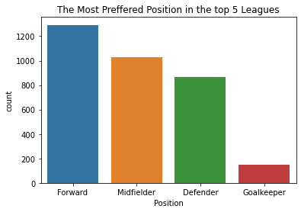
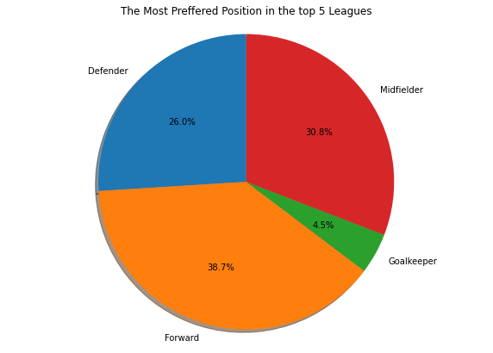
The Most Preferred Position in the top 5 leagues
From the above two graphs (histogram and pie chart) we can notice that the Forward position is the most requested position compared to the other positions in the top 5 Leagues.

Slide 3
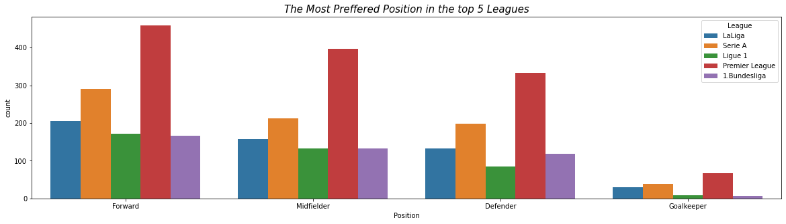
From this graph we can notice that the Premier League is most preferable league for all the players for different positions between the years 2000 and 2018. The league that follows the Premier league is the Serie A.

Slide 4
HOW MANY TRANSFERS ARE MADE EACH SEASON ?

Slide 5
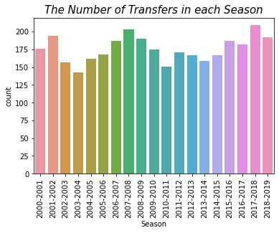
We can notice that the Season 2017-2018 contains the highest number of Transfers 209.

Slide 6
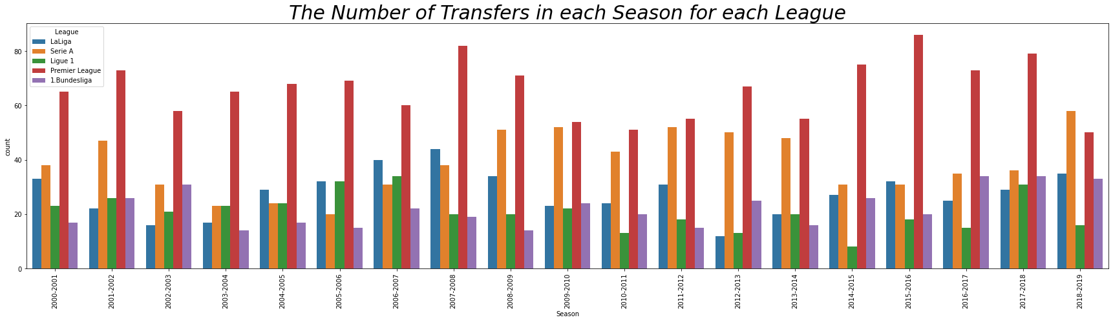
We can notice that Premier League has the most number of transfers in each Season compared to other Leagues except in the season 2018-2019 in which Serie A surpass the other Leagues especially the Premier League.

Slide 7
WHICH LEAGUE PAYS THE MOST MONEY IN THE TRANSFER MARKET?

Slide 8
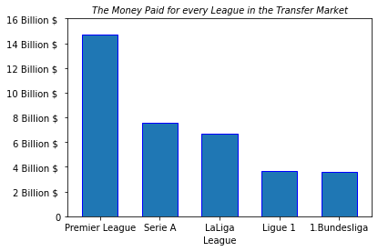
From here we can notice that the Premier League is the league which pays the most money in the transfer market while the 1.Bundesliga is the lowest league which pays money in the transfer market.

Slide 9
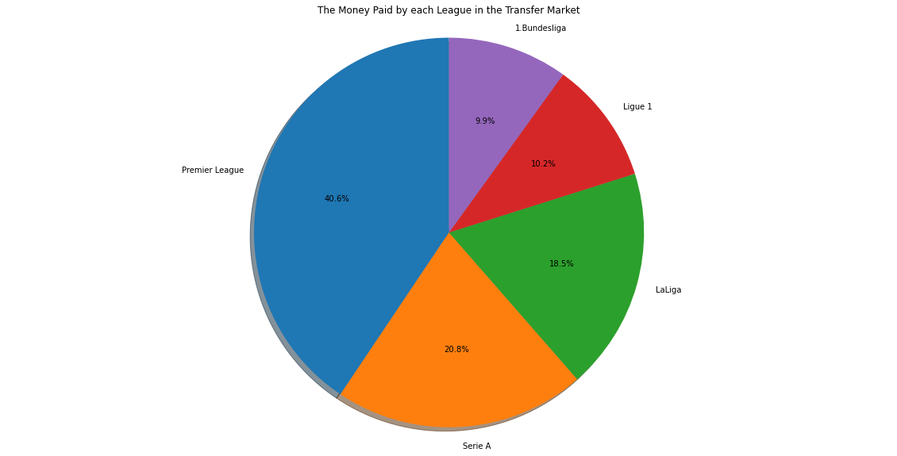
The Premier League is the League which paid the most money of percentage 40.6% while the 1.Bundesliga is the League which paid the least money of percentage 9.9%.

Slide 10
WHICH LEAGUE GAINS THE MOST MONEY FROM SELLING PLAYERS ?

Slide 11
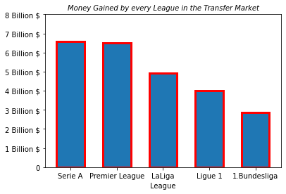
We can notice that Serie A is the most League that gains money by selling its players however Premier League can be considered also with the most leagues that gains money since it is approximately equal to Serie A. However, 1.Bundesliga is the league that gains the least money by selling its players.

Slide 12
DO THE TOP 5 LEAGUES MAKE PROFIT OR LOSSES FROM BUYING AND SELLING PLAYERS ?

Slide 13
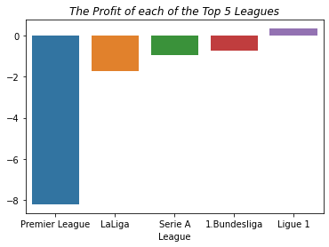
Approximately all the Leagues losses except Ligue 1 which gains approximately 320,040

Slide 14
LEAGUE OF THE MOST NUMBER OF TRANSFERS

Slide 15
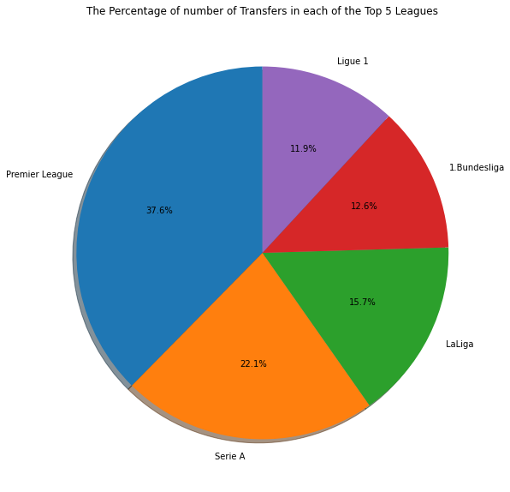
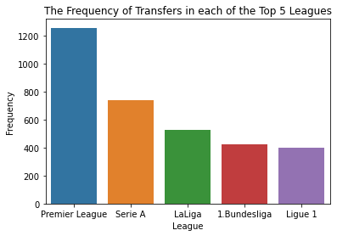
The Premier League has the highest percentage of transfers with 37.6 % while the 1.Bundesliga has the lowest percentage of transfers with 11.9 %

Slide 16
TEAMS WITH THE LARGEST TRANSFER FEE

Slide 17
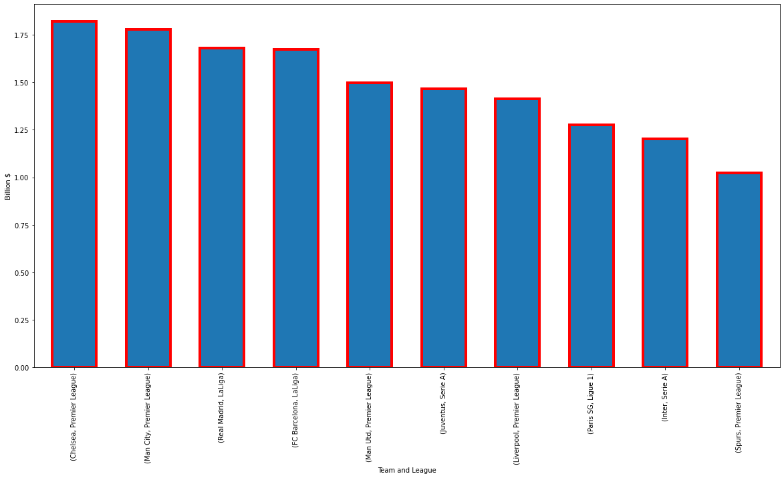
From the top 10 teams that have the largest transfer fees, we can notice that Chelsea is the team with the largest transfer fees compared to the other teams.

Slide 18
WHICH TEAM GAINS THE MOST MONEY IN TRANSFER MARKET

Slide 19
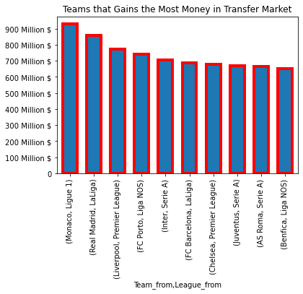
Monaco is the team that benefits the most from buying its players.

Slide 20
TEAMS WITH THE MOST TRANSFERS IN THE TOP 5 LEAGUES

Slide 21
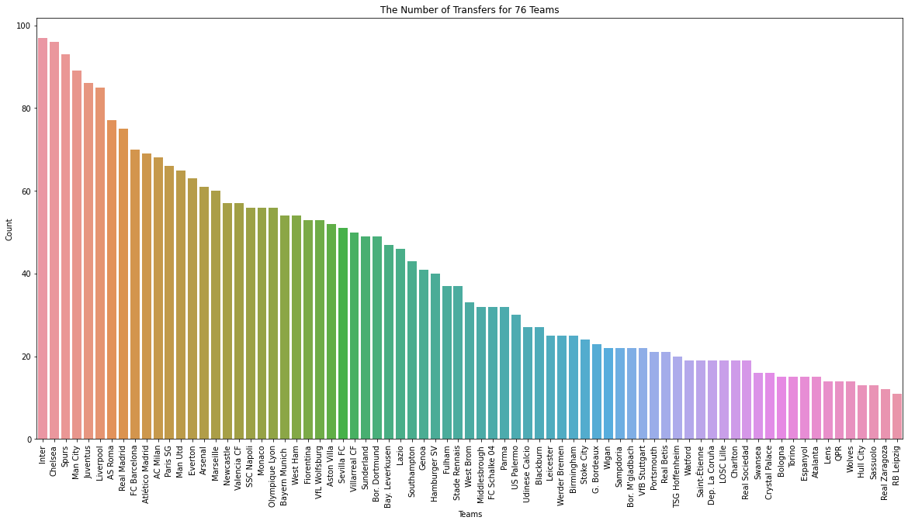
Inter is the team of the top 5 leagues that contains the largest frequency of Transfers.

Slide 22
TEAMS WITH THE MOST TRANSFERS IN the LEAGUES

Slide 23
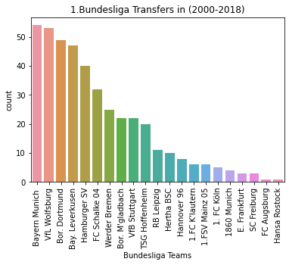
Bayern Munich is the team that contains the largest number of transfers with 54 transfer while Hansa Rostock is the team with the lowest number of transfers with 1 transfer only along with FC Augsburg in Bundesliga.

Slide 24
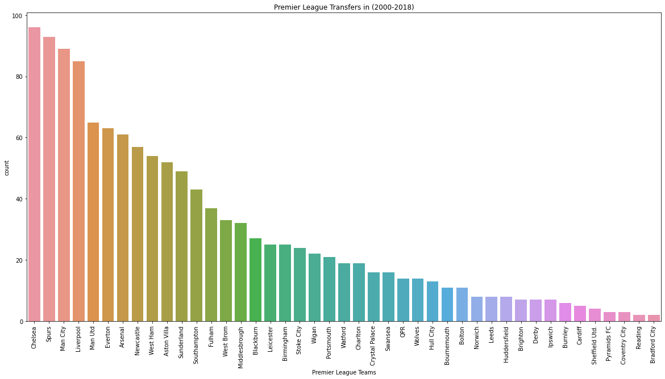
In addition to that Chelsea is the team of the highest transfers between the leagues it is also the team of the highest transfers in the premier league with 96 transfer while Bradford City is the team with the lowest transfers with 2 along with Reading

Slide 25
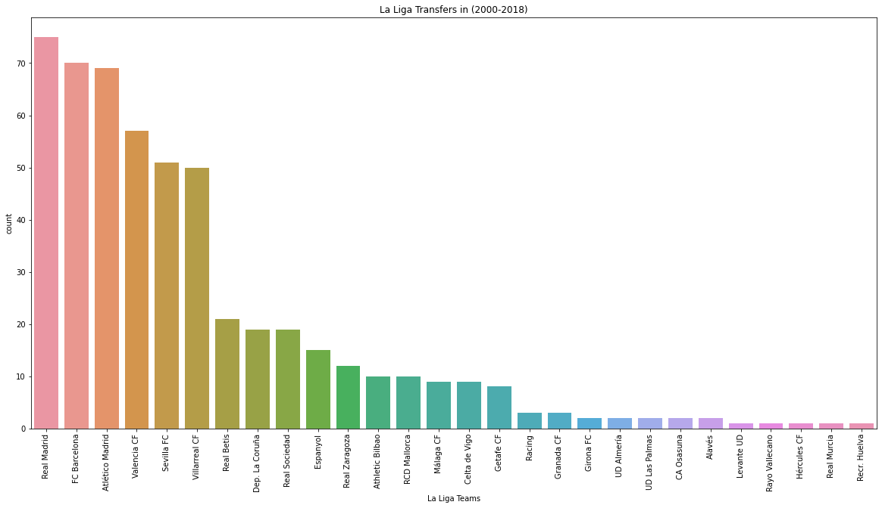
Real Madrid is the team that contains the largest number of transfers with 75 transfer while Levante ID is the team with the lowest number of transfers with 1 transfer only along with Rayo Vallecano ,Hercules CF ,Real Murcia , Recr . Huelva in La Liga

Slide 26
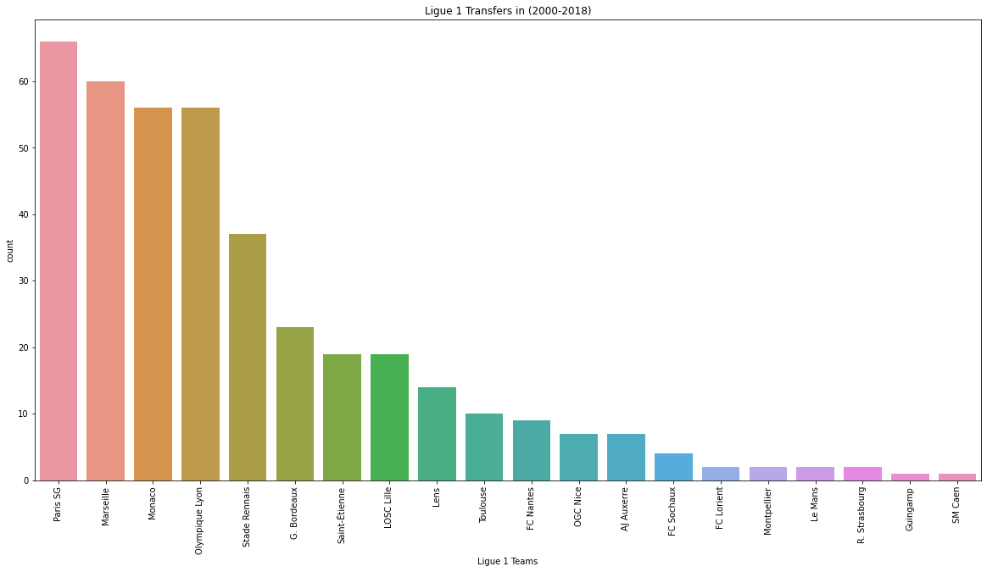
Paris SG is the team that contains the largest number of transfers with 66 transfer while Guingamp is the team with the lowest number of transfers with 1 transfer only along with SM Caen in Ligue 1.

Slide 27
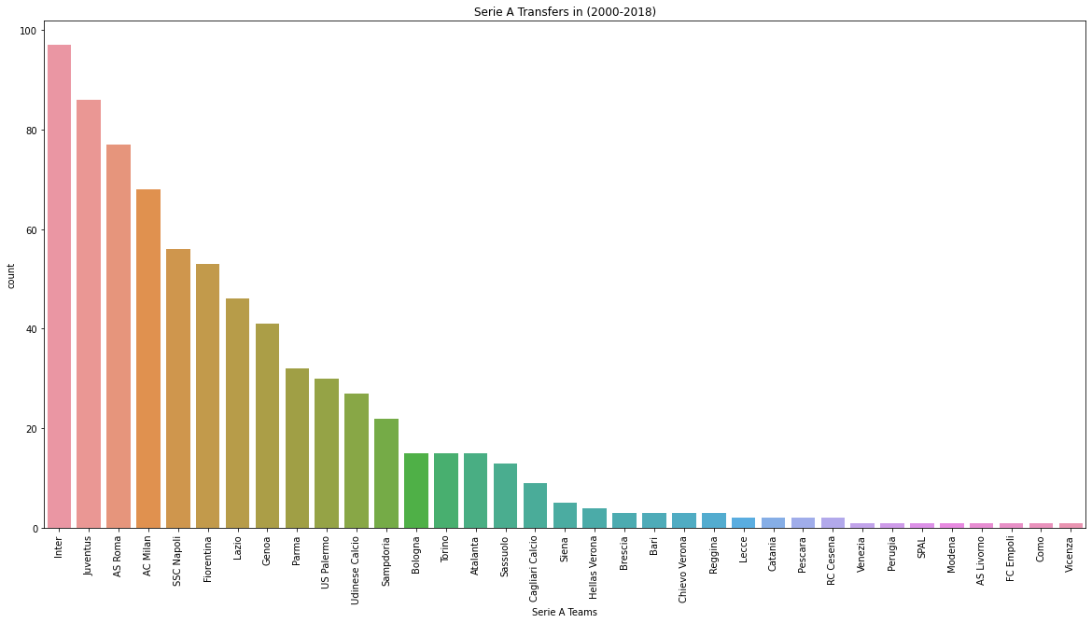
Inter is the team that contains the largest number of transfers with 97 transfer while Venezia is the team with the lowest number of transfers with 1 transfer only along with Perugia, SPAL, Modena, AS Livorno, FC Empoli, Como, Vicenza in Serie A.

Slide 28
PLAYERS STATISTICS

Slide 29
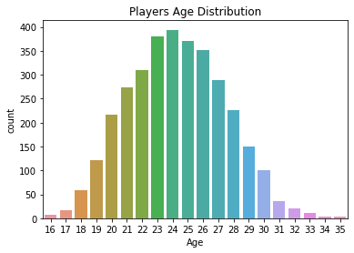
Players Age distribution:
This shows that the average age of a football player is 24 years old since age 24 has the highest frequency.

Slide 30
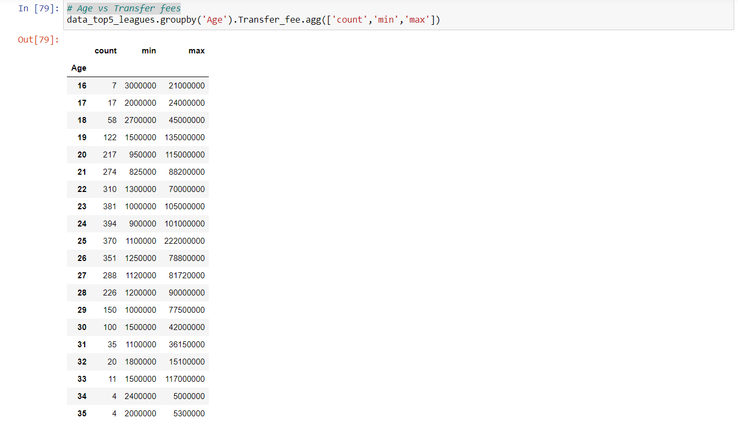
Age vs Transfer fees

Slide 31
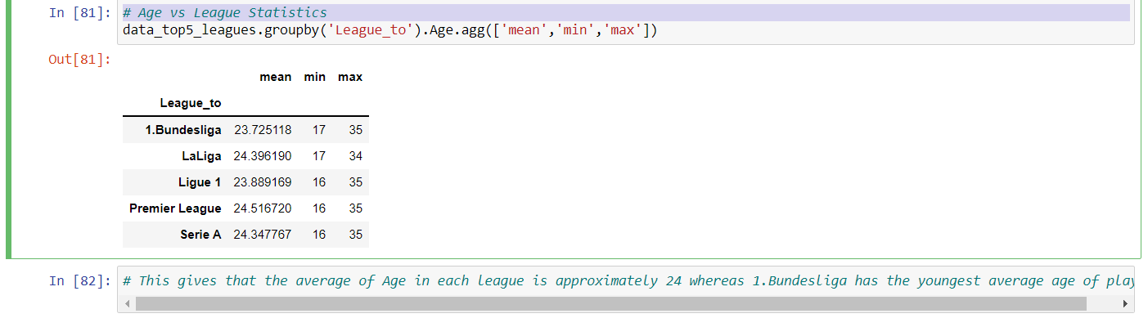
Age vs League Statistics
This gives that the average of Age in each league is approximately 24 whereas 1.Bundesliga has the youngest average age of players

Slide 32
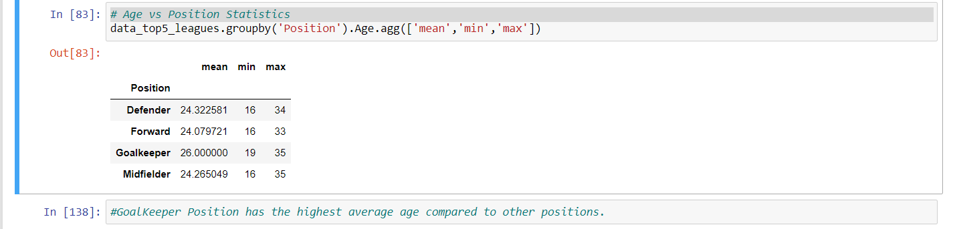
Age vs Position Statistics

Slide 33
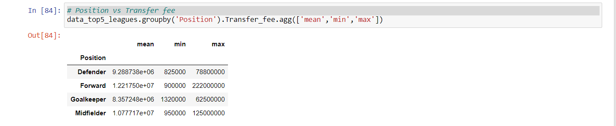
Position vs Transfer fee
Forward position have the highest average of transfer fee whereas the Goalkeeper position have the lowest average of transfer fee.

Slide 34
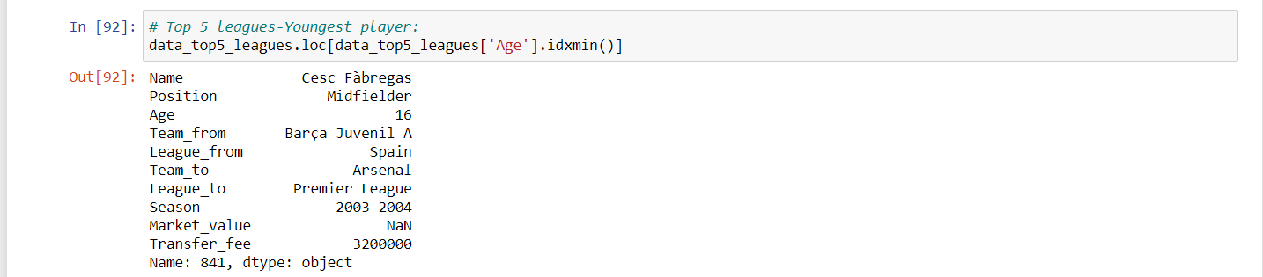
Top 5 leagues-Youngest player:

Slide 35
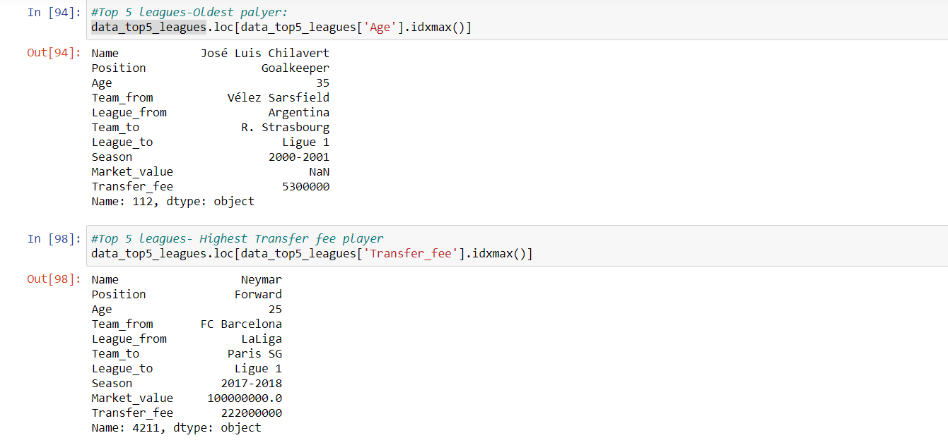
Top 5 leagues-Oldest player- Highest Transfer fee player

Slide 36
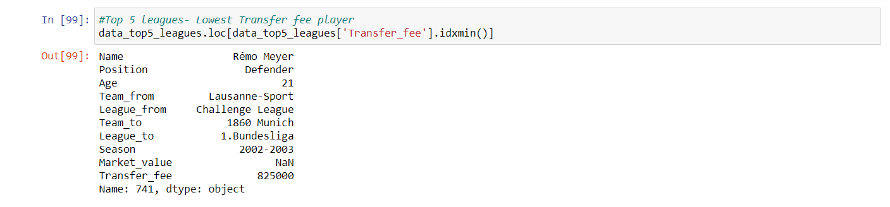
Top 5 leagues - Lowest Transfer fee player

Slide 37
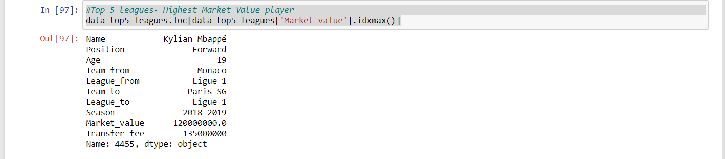
Top 5 leagues- Highest Market Value player

Slide 38
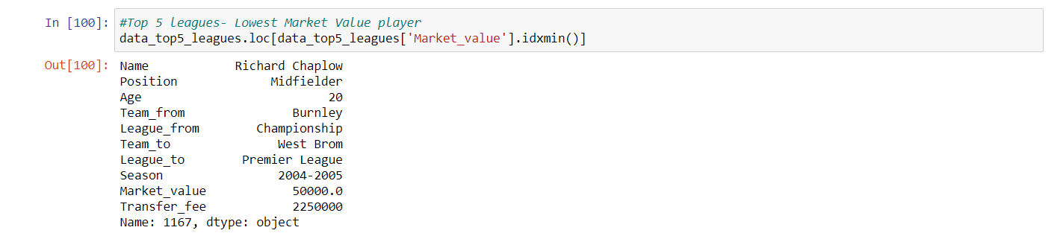
Top 5 leagues- Lowest Market Value player

Slide 39
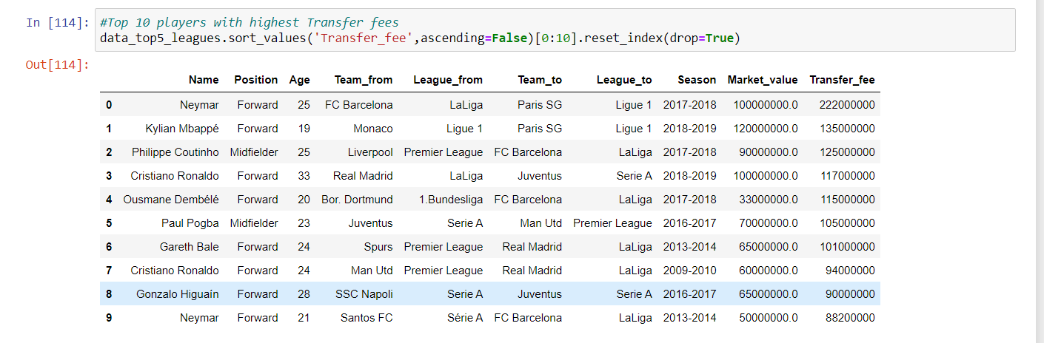
Top 10 players with highest Transfer fees

Slide 40
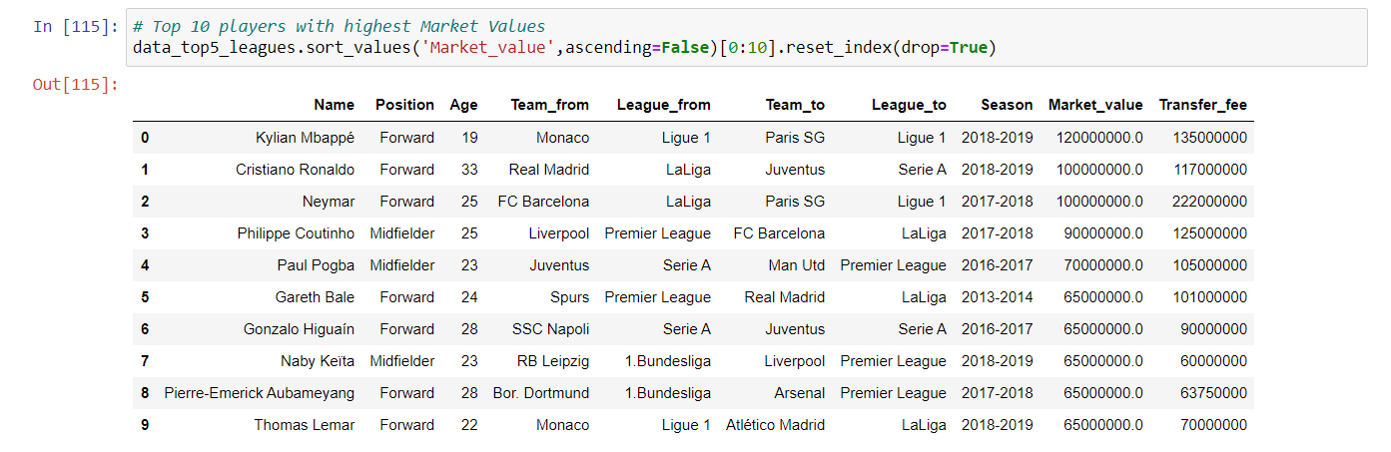
Top 10 players with highest Market Values

Slide 41
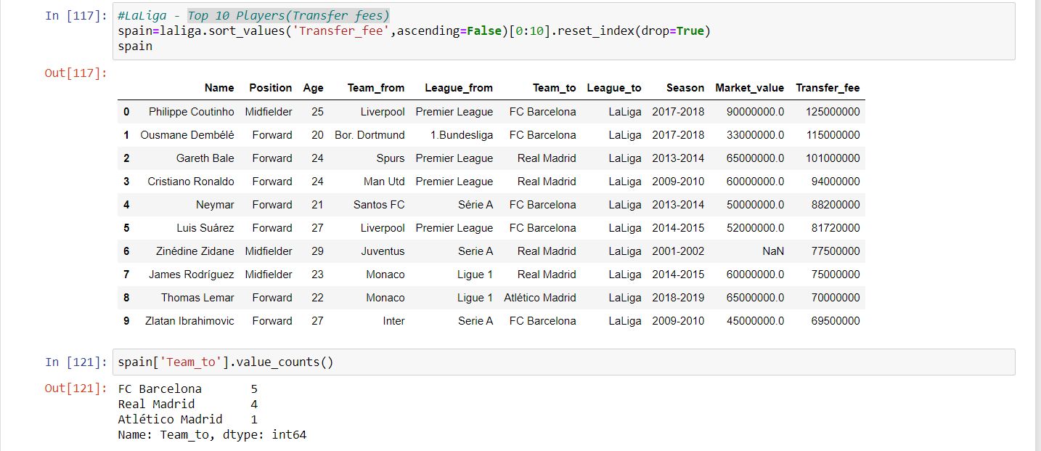
LA Liga - Top 10 Players(Transfer fees)

Slide 42
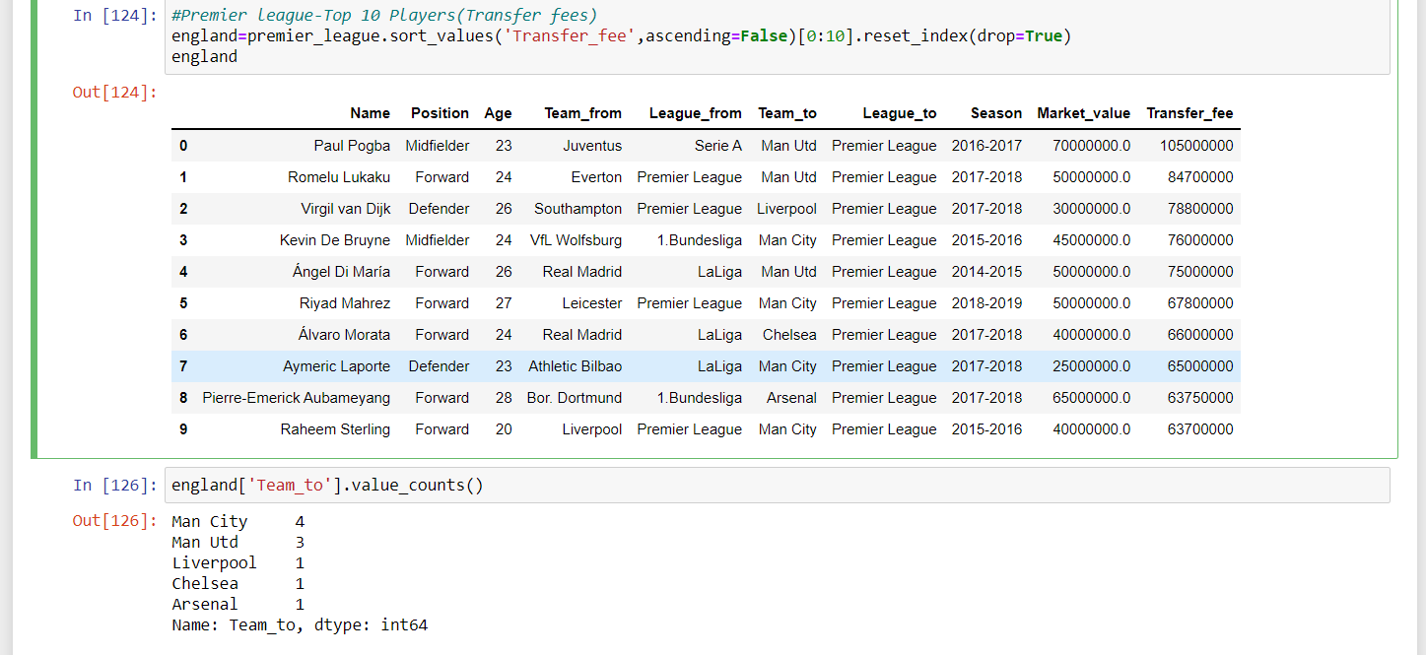
Premier league-Top 10 Players(Transfer fees)

Slide 43
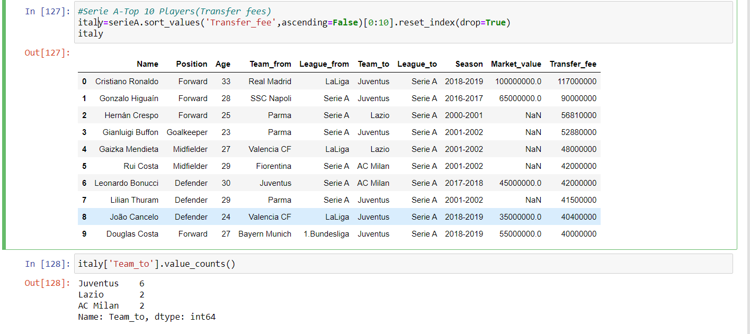
Serie A-Top 10 Players(Transfer fees)

Slide 44
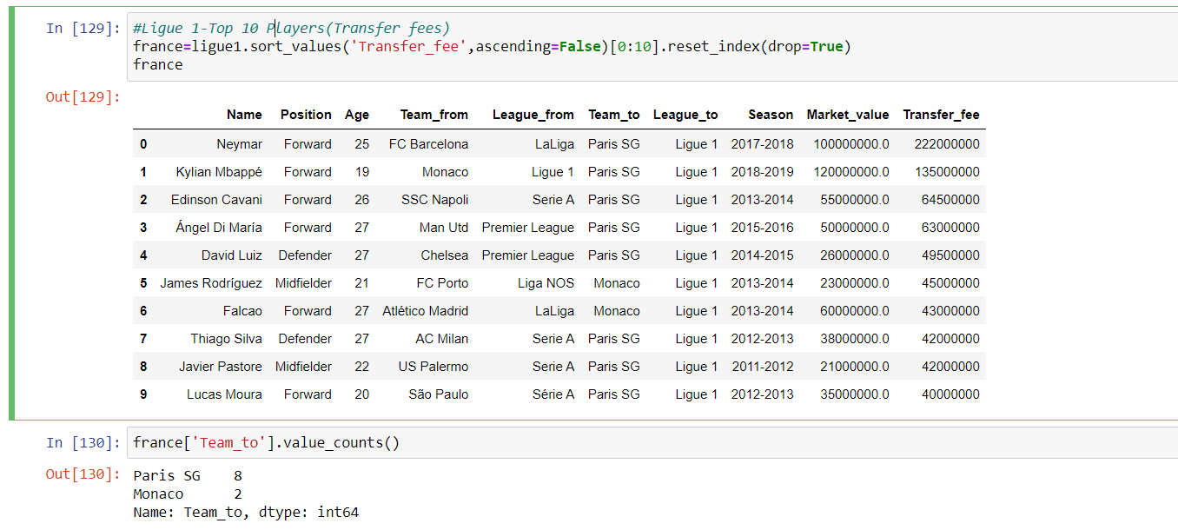
Ligue 1-Top 10 Players(Transfer fees)

Slide 45
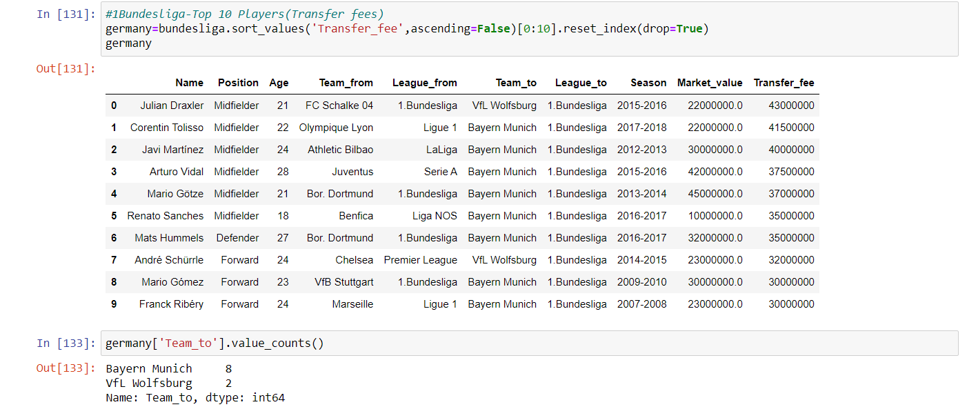
1.Bundesliga-Top 10 Players(Transfer fees)

